Slide 1
California’s Housing Crisis: Context and Urgency
Informational Hearing on State Housing Production Legislation: Actions, Outcomes, and Opportunities
Ben Metcalf Managing Director, Terner Center for Housing Innovation at UC Berkeley
February 12, 2025

Slide 2
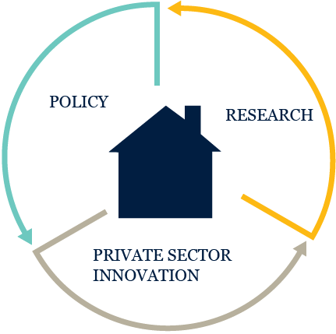
Terner Center’s Approach
Increasing the supply and lowering the cost of housing in ways that align with equity and environmental goals
Expanding access to quality homes and communities to support racial, social, and economic inclusion
Driving innovation in housing policy and practice
TERNER CENTER FOR HOUSING INNOVATION UC BERKELEY

Slide 3
California’s Housing Crisis
How severe is the state’s housing crisis?
TERNER CENTER FOR HOUSING INNOVATION UC BERKELEY

Slide 4
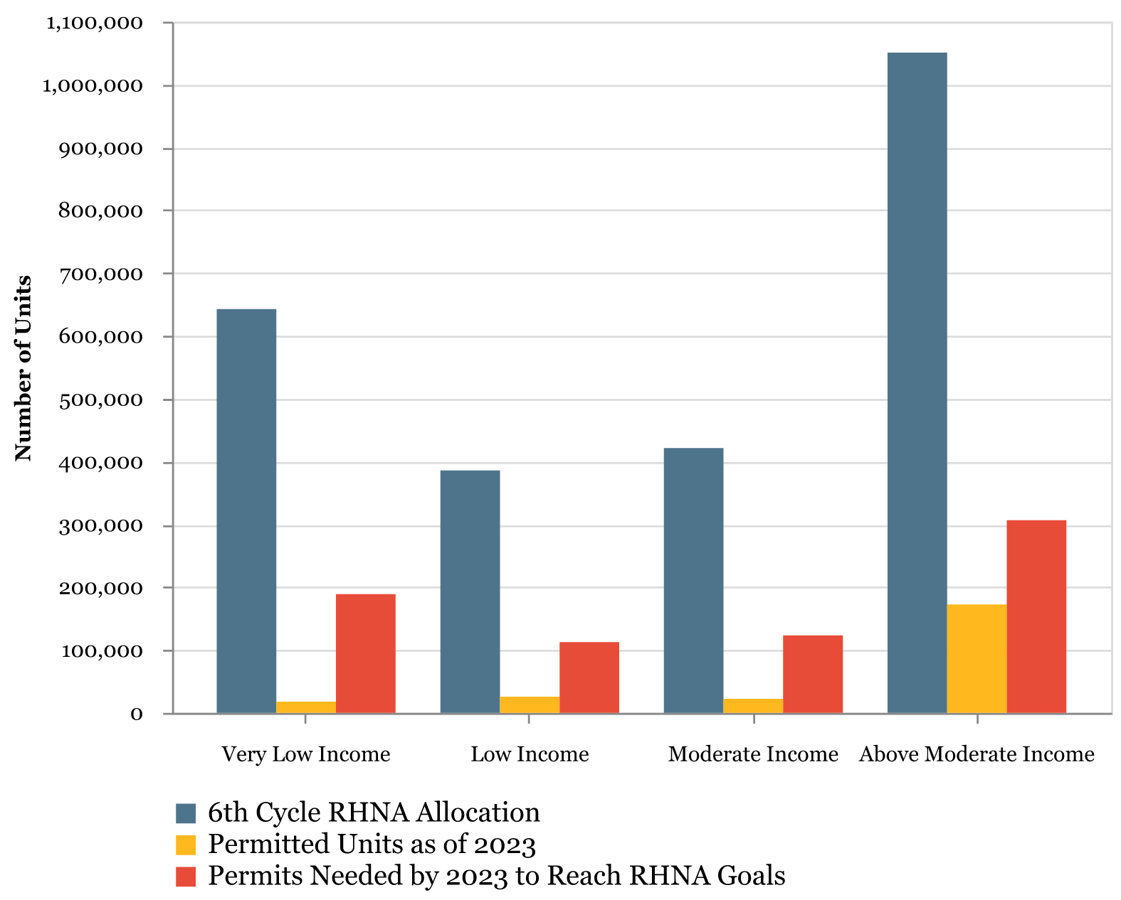
In CA, more than 2.5 million new units are needed by 2032 simply to meet expected population growth.
Note: Depending on the jurisdiction, completion of 6th cycle RHNA permitting for all COGs will not occur until 2032, and APR data for this chart includes permitted projects only through 2023.
Source: Terner Center Analysis of HCD Annual Progress Report data
TERNER CENTER FOR HOUSING INNOVATION UC BERKELEY
Notes:
Partially due to the undersupply, the projected need between 2001 and 2028 is more than 1.7 million additional units
This is a more than 50% increase from the previous 8-year projection
This would require an average of more than 200,000 units produced per year
Suffice to say, this is no small task, and without significant intervention in the processes and policies behind housing development in California, we’re unlikely to meet the huge housing need

Slide 5
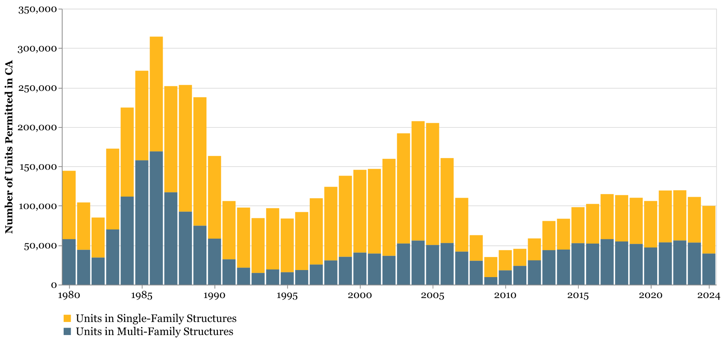
Even with recent reforms, overall production is stagnant.
Source: Terner Center analysis of HUD and Census BPS data
TERNER CENTER FOR HOUSING INNOVATION UC BERKELEY

Slide 6
Despite record spending, we are nowhere near meeting affordable housing goals.
Affordable Housing Funded vs. Need
TERNER CENTER FOR HOUSING INNOVATION UC BERKELEY
Source: California Housing Partnership
Notes:
https://chpc.net/california-meeting-needs-of-low-income-renters/

Slide 7
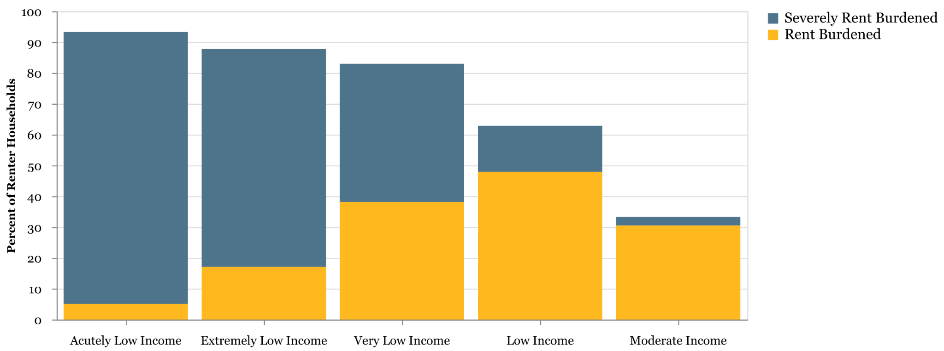
High Housing Cost Burden across California, 2023
54.7% of all CA renters are rent burdened
Source: Terner Center Analysis of US Census Bureau, Public Use Microdata Sample (PUMS) 2023.
TERNER CENTER FOR HOUSING INNOVATION UC BERKELEY
Notes:
Cost burden is greater than 30%, severely is greater than 50%. Acutely Low Income (0%-15% AMI),
Extremely Low Income (15%-30% AMI), Very Low Income (30%-50% AMI), Low Income (50%-80% AMI),
Moderate Income (80%-120% AMI)

Slide 8
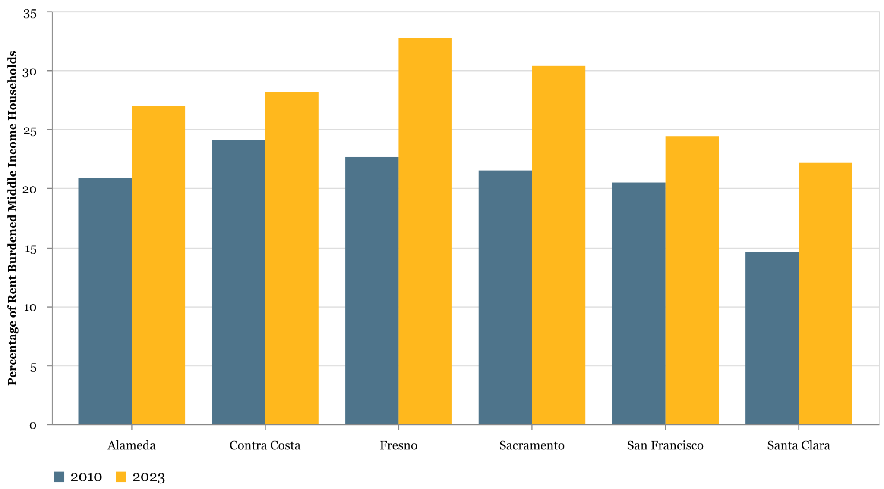
Middle-Income Renters Paying >30% of Income in Rent, 2010 vs. 2023
Source: Terner Center Analysis of US Census Bureau, Public Use Microdata Sample (PUMS), 2010 & 2023.
TERNER CENTER FOR HOUSING INNOVATION UC BERKELEY
Notes:
Little affordability pressures in Fresno and Sac and income have gone up in SF, but SC, CC, and Alameda all challenged

Slide 9
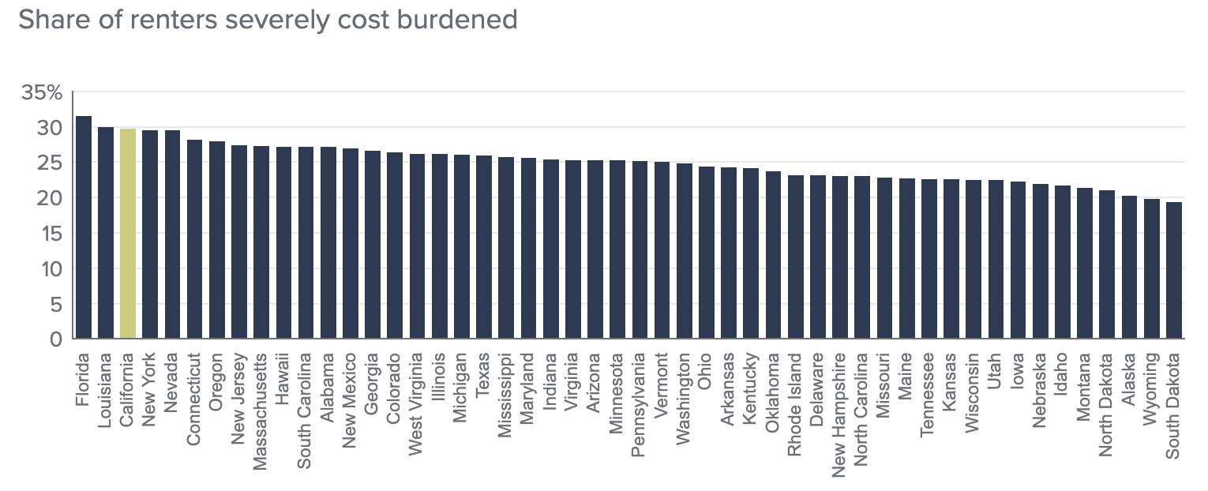
Renter stress is more common in California than other states. (2024)
Source: Public Policy Institute of California
TERNER CENTER FOR HOUSING INNOVATION UC BERKELEY
Notes:
California has more rental stress than most other states, with nearly 30% of renters are cost-burdened, spending more than 30% of their income on rent.

Slide 10
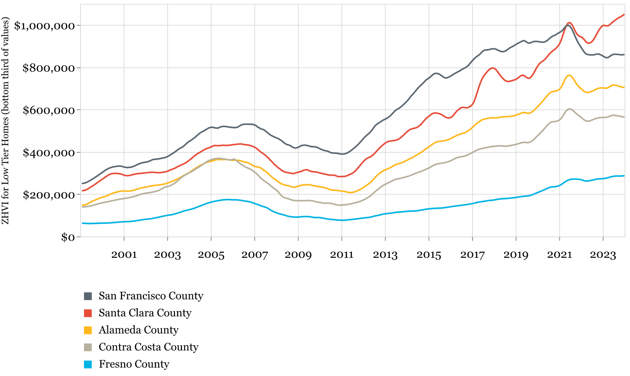
New entry-level housing stock tends to be sold at higher price points.
Source: Zillow House Value Index (ZHVI). Entry-level homes are defined as those comprising the bottom third of house prices in the metro area.
TERNER CENTER FOR HOUSING INNOVATION UC BERKELEY

Slide 11
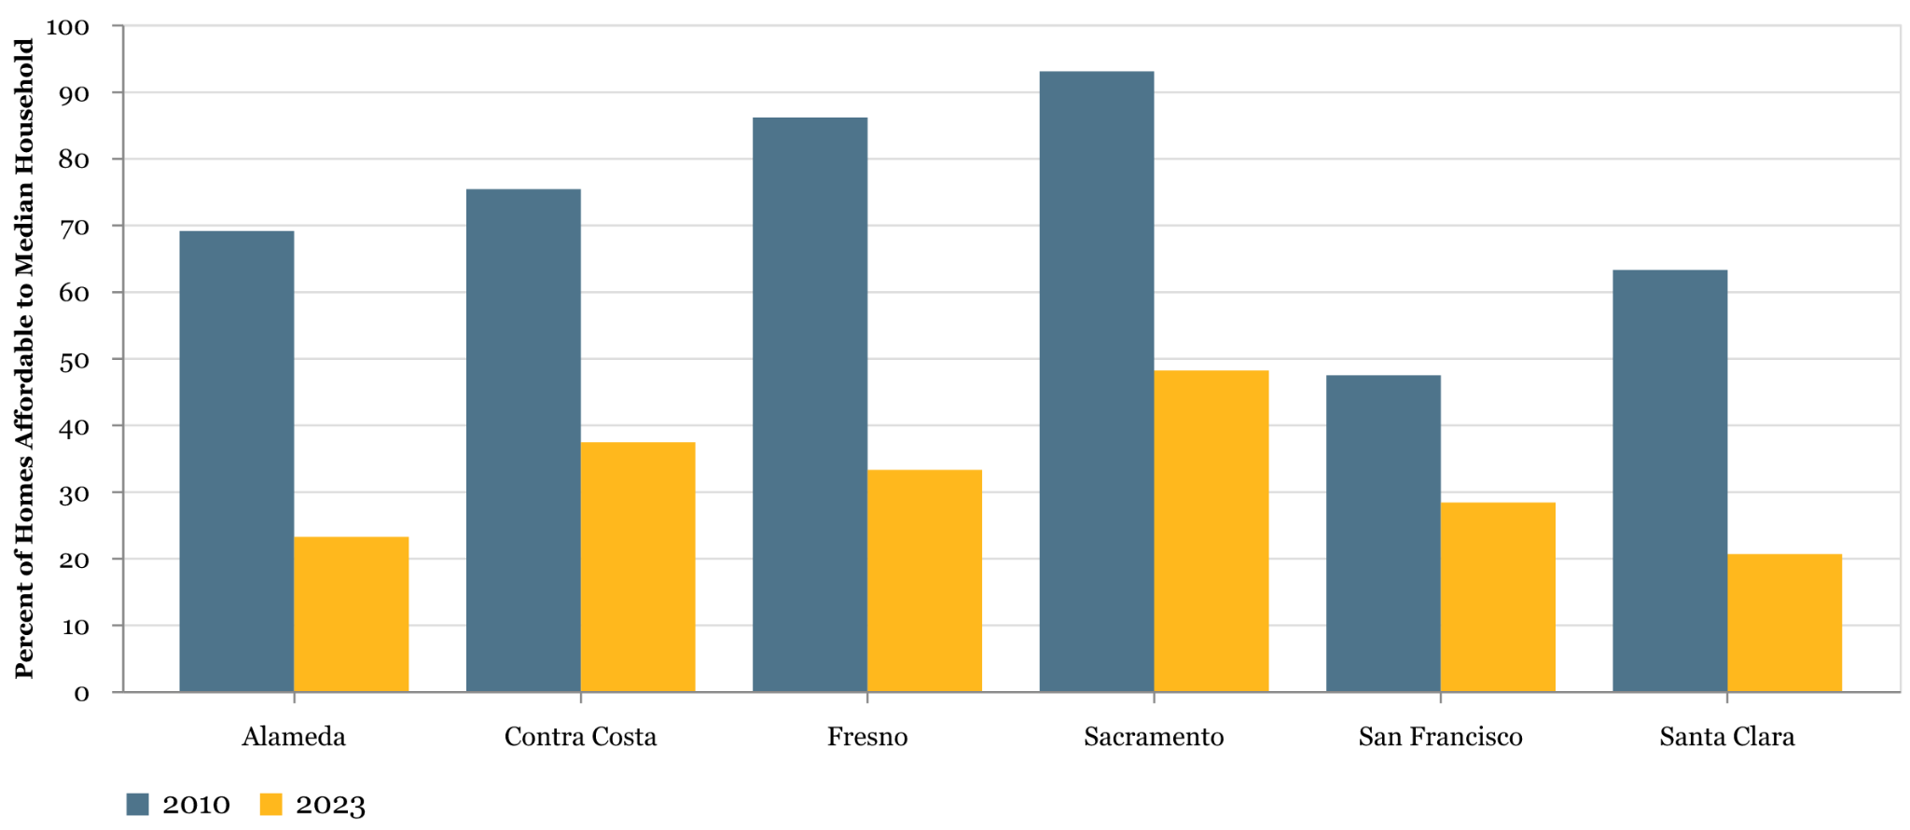
Homes Affordable to Middle-Income Households, 2010 vs. 2023
Note: This analysis estimates the percentage of home loan mortgages a median-income, four-person household could afford if it allocated up to 30% of its income to mortgage payments. It assumes that the household has already secured enough funds for a down payment.
Source: Terner Center analysis of 2010 and 2019 Home Mortgage Disclosure Act data.
TERNER CENTER FOR HOUSING INNOVATION UC BERKELEY
Notes:
To provide just one example, in 2000, a public school teacher with an average salary of $68,000 would have earned enough to buy a median-priced home. Today, that same teacher would have to earn closer to $115,000 to buy the median-priced home in California, but the average teacher salary has increased to only $78,000. If they worked in Oakland, where teacher salaries are in line with the statewide average, they would need to earn closer to $170,000 to be able to buy a median-priced house—assuming they could come up with a $200,000 down-payment.

Slide 12
The inadequate supply of housing has a host of negative economic and social consequences.
For communities/regions: Difficulty in attracting employers and economic investment Harder to respond to changing climate Increasing racial and economic segregation | For people: Less residual income for non-housing Increased precarity and likelihood of homelessness Declining economic mobility Increasing anti-incumbent bias and political polarization
TERNER CENTER FOR HOUSING INNOVATION UC BERKELEY

Slide 13
And these consequences do not affect everyone equally.
The housing crisis impacts almost everyone in California, but for some, the impacts are much more dramatic, including:
Economic: Lower-income, single earner
Racial: Black and Latino
Demographic: Young and elderly
Geographic: Those who (aspire to) live/work in highest-cost regions
Economically mobile: Those trying to get ahead
TERNER CENTER FOR HOUSING INNOVATION UC BERKELEY

Slide 14
California’s Housing Crisis
What’s working?
TERNER CENTER FOR HOUSING INNOVATION UC BERKELEY

Slide 15
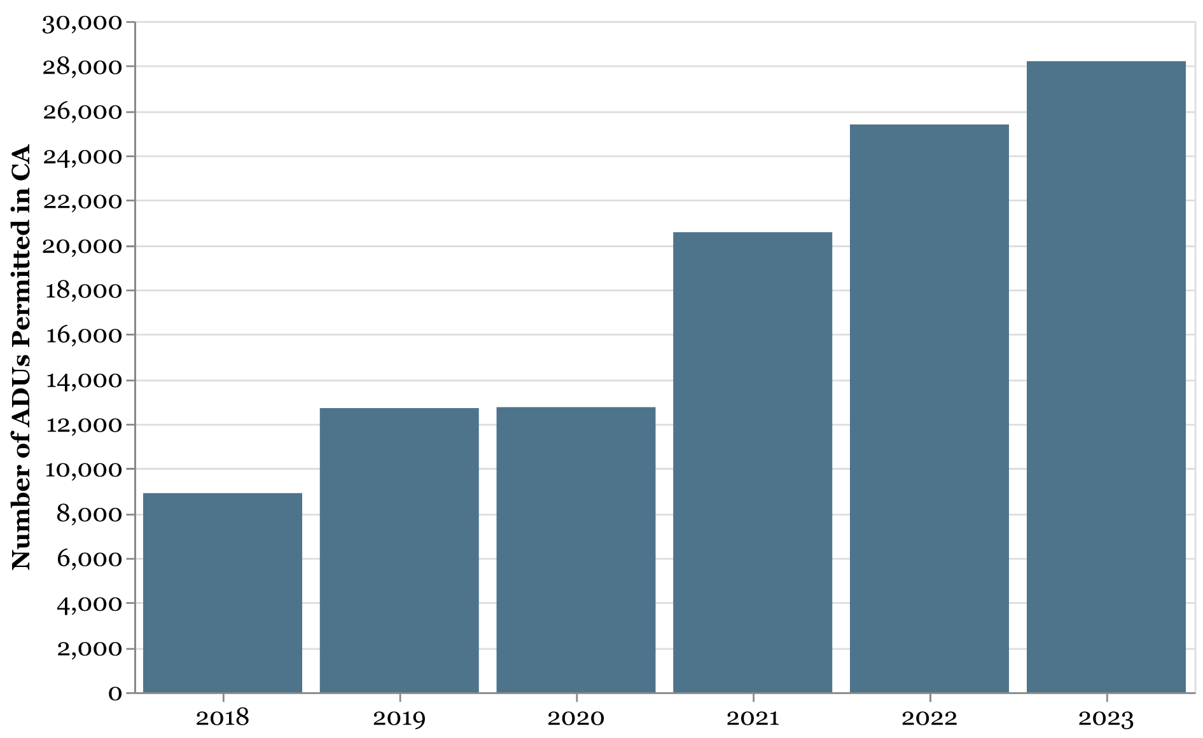
ADUs: A California Success
ADUs are built ministerially, with little to no impact fees and strict permitting timelines.
Many units are naturally affordable to households at or below 80 percent of Area Median Income (and often in areas with few other affordable options).
ADU permitting increased from 8,900 units in 2018 to 28,210 in 2023.
TERNER CENTER FOR HOUSING INNOVATION UC BERKELEY
Source: HCD ADU Handbook

Slide 16
Another Success:
Senate Bill 35/423 / State Density Bonus Combo
Senate Bill 35/423 (Weiner, 2017/2024) provides a streamlined ministerial approval process for multifamily infill projects in jurisdictions that are not on track to meet their RHNA goals.
Successfully paired with other state laws: Affordable housing developers frequently use this with state Density Bonus Law to increase by-right approvals for units by 50% or more of base zoning and to secure many zoning concessions/waivers.
Increases number of viable projects and pulls forward project construction start: The 90-day requirement for approval vastly accelerates multi-year approvals projects.
Source: HCD’s Guidelines for Government Code Section 65913.4, Updated Streamlined Ministerial Approval Process
TERNER CENTER FOR HOUSING INNOVATION UC BERKELEY

Slide 17
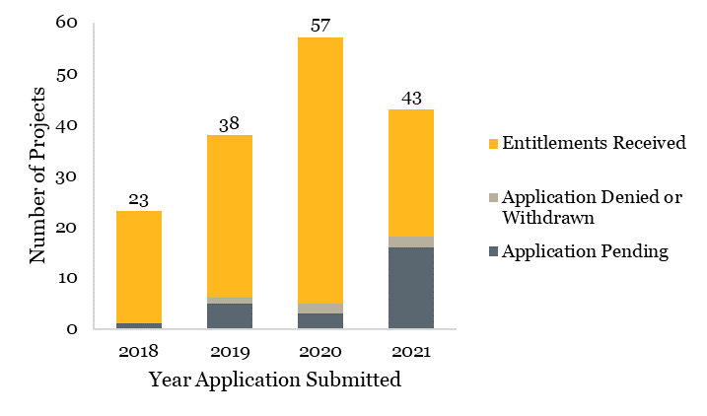
Between 2018 and 2021, 156 projects were approved or pending for SB 35 streamlining, comprising over 18,000 new housing units.
Proposed SB 35 Projects by the Year of Application and Project Status as of 2021
Source: Terner Center analysis of Annual Progress Report Data, 2018–2021. Note: The chart includes all 161 proposed SB 35 projects, including those that were denied or withdrawn.
TERNER CENTER FOR HOUSING INNOVATION UC BERKELEY

Slide 18
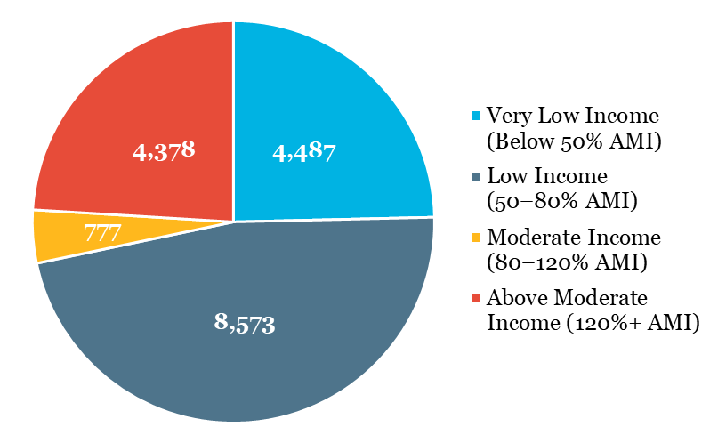
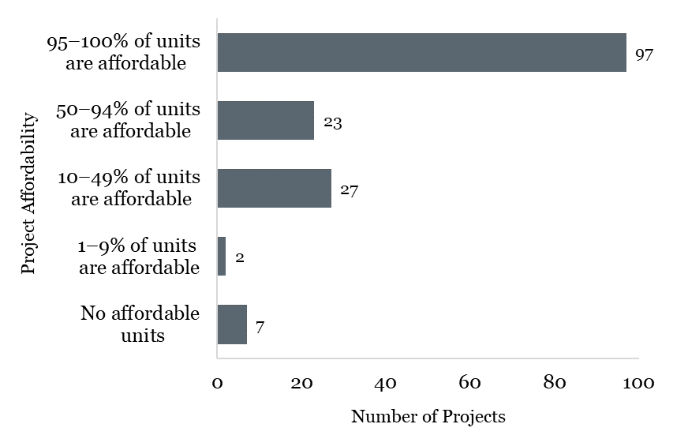
Most housing units proposed through SB 35 are affordable, and most SB 35 projects include all affordable units.
Number of units in SB 35 projects by affordability
Number of SB 35 Projects by the Share of Affordable Units
TERNER CENTER FOR HOUSING INNOVATION UC BERKELEY

Slide 19
Other upzoning and streamlining efforts show promise but are harder to quantify.
SB 330
AB 2234
Cities like Sacramento, San Diego, and San Jose have led on local zoning/streamlining options, motivated by the 6th cycle housing element.
San Francisco offers an interesting test case with their reforms going into the 7th cycle housing element.
Limits local government’s ability to impose new regulations, fees, or restrictions
Establishes mandatory timelines for local agencies to approve or reject housing applications
TERNER CENTER FOR HOUSING INNOVATION UC BERKELEY
Notes:
SB 9, ADU bills, AB 2011, SB 684, SB 4, AB 1287, AB 2097, Assembly Bill 2234 (Rivas, 2022) approve or deny various building permits within a timeline: 30 days for small housing projects with 25 or fewer units and within 60 days for large projects with 26 or more units
The Permit Streamlining Act sets short deadlines, but of course cities are the ones who decide whether an application is complete. So, even with the PSA, cities and developers can get into a long back-and-forth as to whether an application is complete. And, of course, the CEQA process is completely unpredictable. You can end-run CEQA altogether with something like SB 35 (which essentially requires union labor), or you can get bogged down in a multiyear EIR process and then get sued. It is worth noting that Holland & Knight found that around half of housing units in California get sued under CEQA, which even if the lawsuit is unsuccessful slows things down.

Slide 20
Beyond Upzoning/Streamlining:
Unseen Barriers to Housing Construction
Need for increased local capacity: challenges of implementing state housing laws and ongoing need for supporting local/regional public agencies that review/support housing construction
Rapidly increasing costs: including insurance, financing, material, labor, building code increases, local impact fees
State housing governance complexity: opportunities for reorganization
Federal government: tariffs, deportation-enabled labor shortage, budget cuts
TERNER CENTER FOR HOUSING INNOVATION UC BERKELEY

Slide 21
More on California Housing from the Terner Center

